Slide 1

Patient Management in the ER
Document Code: ZCMC-PR-01
Revision No.: 0
Date Effective: September 30, 2022

Slide 2

General Information
Procedure: Patient Management in the ER
General Information
A. Objectives
To ensure consistent quality of ER Services that meets requirements of patient
B. Terms/Definitions/Acronyms:
ER – Emergency Room Triage – the sorting of patients according to the urgency of their need for care
C. Scope
This procedure covers services related to all activities from triage of patient upon entry to ER up to the final disposition of the doctor to triage.
Page 2

Slide 3
Process Flow
Procedure: Patient Management in the ER
Process Interactions
OPD
Laboratory
Pharmacy
Admission
S
I
P
O
C
3. Patient Management
Output:
ER Services
Customer
(Receiver of Outputs)
Patients / Watchers
Supplier
(Source of Inputs)
Patients / Watchers
Inputs:
Patient Need for Care
1. Triage
3.1Medical Service
Treatment
Referrals
Doctor’s Order
2. Initial Assessment
Disposition
3.2 Nursing Service
Carrying Out Doctor’s Orders
Vital Signs
Medication
Nursing Procedures
Discharge
Acceptance Criteria For Outputs
Disposition within 4 hours upon admission
Patient stabilized
90% Client Satisfaction for ER Services

Slide 4

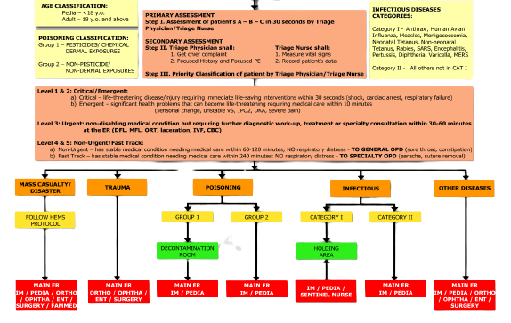
Activity Details: 1. Triage
Procedure: Patient Management in the ER
Responsibility and Authorities
Triage Nurse
Instructions:
1.1 The triage nurse shall triage all patients based using the triage flowchart as a guide.
1.2 If the patient is assessed as an OPD Case, the triage nurse shall direct the patient to the OPD.
1.3 If the patient is assessed ad emergent or urgent, he/she will be issued with Medical Record for encoding.
1.4 Refer to Work Instruction - Triaging
Entry To ER

Slide 5
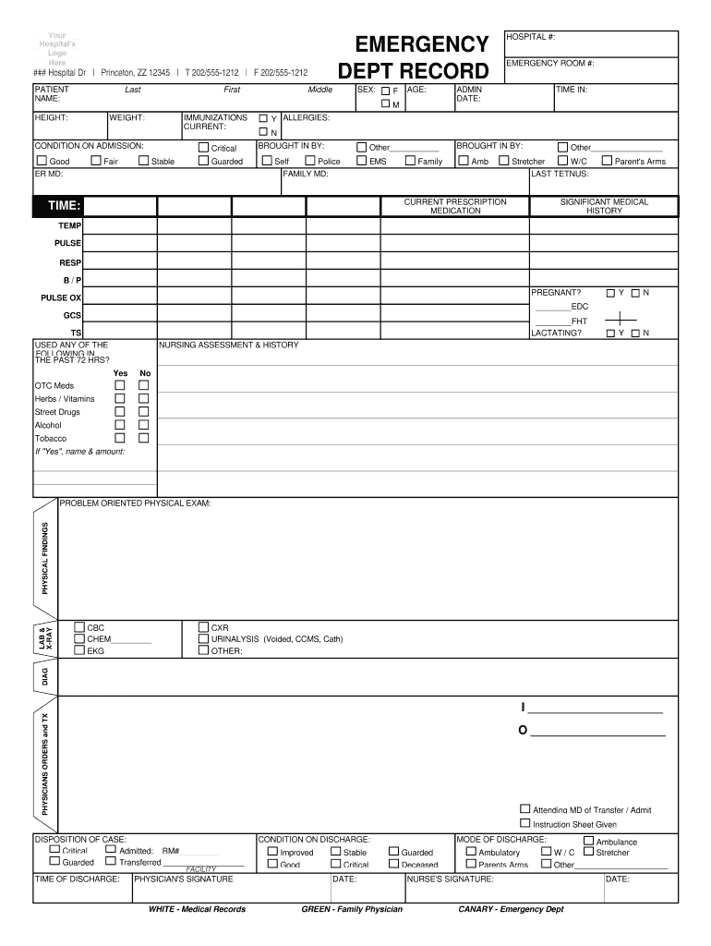
Activity Details: 2. Initial Assessment
Procedure: Patient Management in the ER
Responsibility and Authorities
ER Physician
Instructions:
2.1 The ER Physician shall conduct an initial assessment with the patient based on medical record.
2.2 This include the patient history, subjective, objective, assessment.
2.3 The ER Physician shall indicate initial assessment in the form.

Slide 6
Activity Details: 3.1 Patient Management
Procedure: Patient Management in the ER
Responsibility and Authorities
ER Physician
3.1.1 The ER Physician shall manage the patient based on the assessment.
3.1.2 The ER Physician shall ensure that doctor’s orders are legibly written.
3.1.3 If diagnostics are necessary, the ER Physician shall order requests to the nurses.

Slide 7
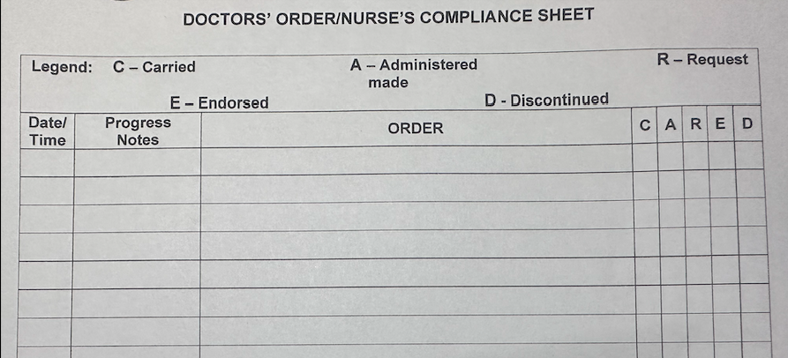
Activity Details: 3.2 Patient Management
Procedure: Patient Management in the ER
Responsibility and Authorities
ER Nurse
3.2.1 The ER Nurse shall carry out the doctor’s order given. Use the CARED system.
3.2.2 If the doctor’s order are given verbally due to urgency of care, it shall be transcribed later.
3.2.3 Ensure that medication are properly provided.
3.2.3 Refer to following:
WI – Carrying Out Doctor’s Order
WI – Medication
WI – Vital Signs Monitoring
WI – Nursing Procedures

Slide 8
Activity Details: 4. Disposition
Procedure: Patient Management in the ER
Responsibility and Authorities
ER Physician
2.1 The ER Physician shall make a disposition whether the patient is to be discharged or admitted.
2.2 If for admission, refer to admission process.
2.3 If for discharge, the doctor shall order nurses to perform discharge instructions.

Slide 9
MONITORING & MEASUREMENT
Procedure: Patient Management in the ER
What To Monitor | When To Monitor | Method For Monitoring | When to Analyze & Evaluate Results
1. Timeliness of Disposition – Within 4 hours | Per patient | Monitoring in the iHOMIS timestamps. | Reports will be summarized at the end of the month. Analyze and evaluate based on the summary.
2. Customer Satisfaction | CSF shall be provided to clients daily | Customer Survey Forms to at least 50% of clients | All CSF forms will be summarized, analyzed and evaluated at the end of the month.
3. Discharged improved rate | Per patient | Based on report in iHOMIS | Reports will be summarized at the end of the month. Analyze and evaluate based on the summary.

Slide 10
Preparation, Review & Approval
Procedure: Patient Management in the ER
Preparation, Review & Approval
Author/s
Name Name Name
Reviewed By:
QMR
Approved By:
Medical Center Chief

Slide 11
Entry To ER
Back
Next Slide

